Slide 1
Light as Particle Light as Wave
These slide notes taken from Tim Burgess lecture PP entitled & shared: "Tim-Burgess-Light morning," June 21, 2022

Slide 2
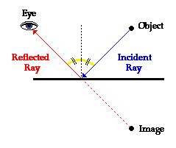
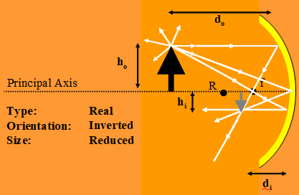
Newtons Particle Model
“Corpuscular Theory of Light” in “Opticks”
Very Fast & very Elastic: evidenced by rectilinear propagation and predictable bouncing (explaining light in mirrors of all types)

Slide 3
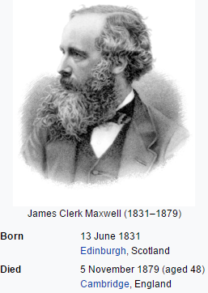
Huygens Wave Model
Diffraction is fully explained by the wave model Refraction is fully explained by the wave model Colors behavior consistent with wavelength Waves pass through without altering propagation Speed changes based on medium and predictable Reflection of waves predictable Maxwell’s calculations exactly predict electromagnetic disturbance and yields wave propagation at Roemer’s speed! Increased energy delivered with increase in intensity

Slide 4
What is Light? We have never seen a photon. We never will see a photon. Instead we use measurements and our imagination to explain the data gathered in experiments.

Slide 5
Take Aways?
During this grueling 2600 year review:
* Physics explains the world
using analogies, metaphors, imagination, speculation, logical consistency and refines these explanations based on both observations and predictions
that are BOTH qualitative and quantitative.
* Modern Physics (quantum Mechanics)
emerged as a result of coming to “see”
particles we will never really see (quanta/photons).
These photons interact with the smallest of atomic and
subatomic particles (which we also can not see) allowing us to probe the universe in ways that extend our ability to observe (and measure)
* The dual nature of light provides a unique analogy
for other disciplines where two simultaneous and
seemingly contradictory properties may co-exist.

